Slide 1
Email Sending Slide of Mailchimp Email Services.
Below is a slide depicting the Email sending process of MailChimp.

Slide 2
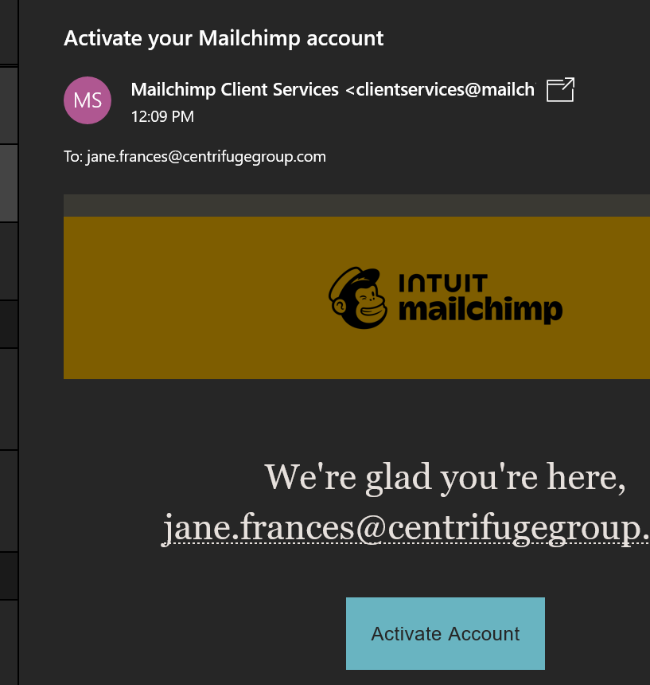
Sign In
This is where you are sent an email link to activate your email.

Slide 3
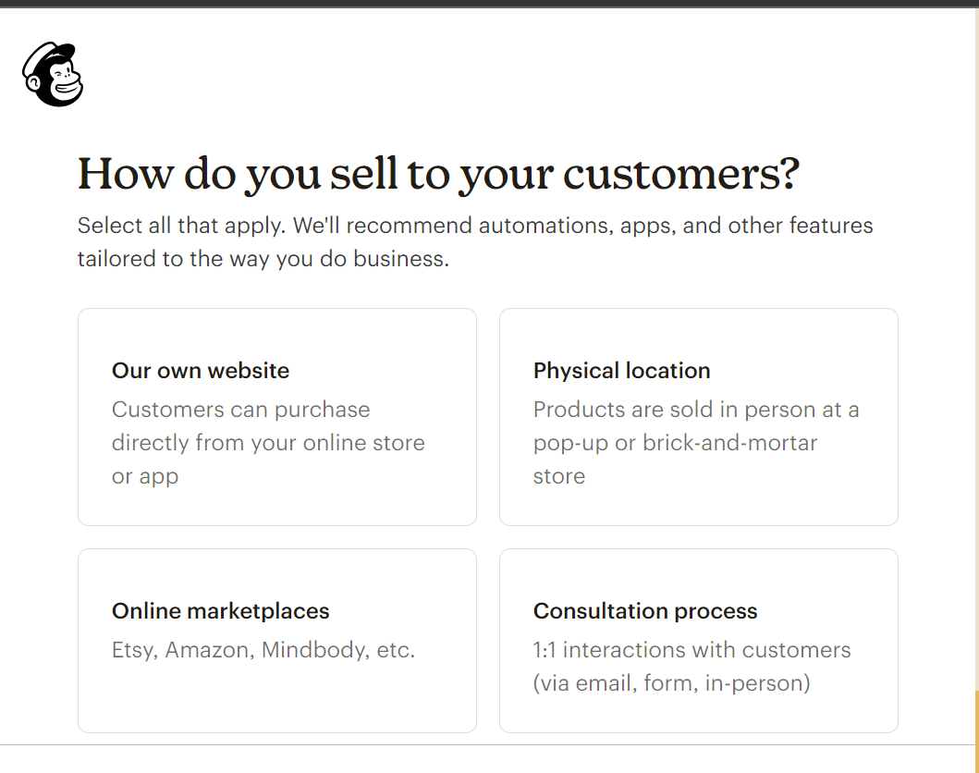
Know your Customer
This page determines the type of email templates, what kind of prompts you receive etc.

Slide 4
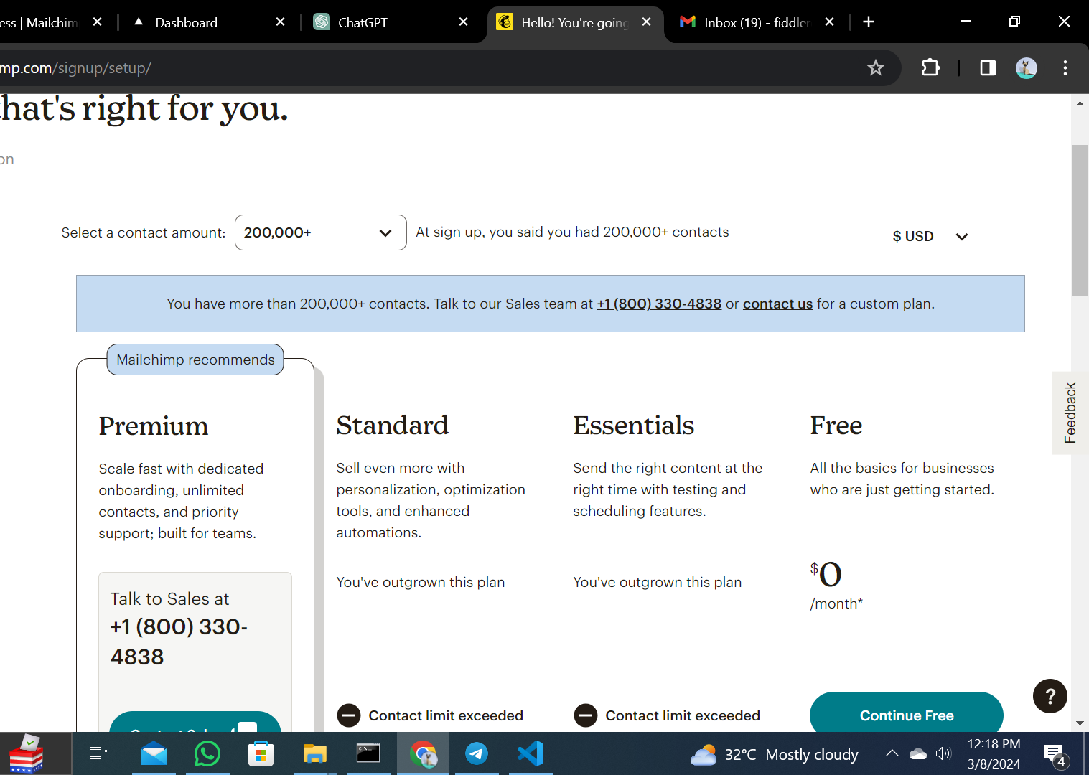
Pricing Plan
I clicked Free

Slide 5
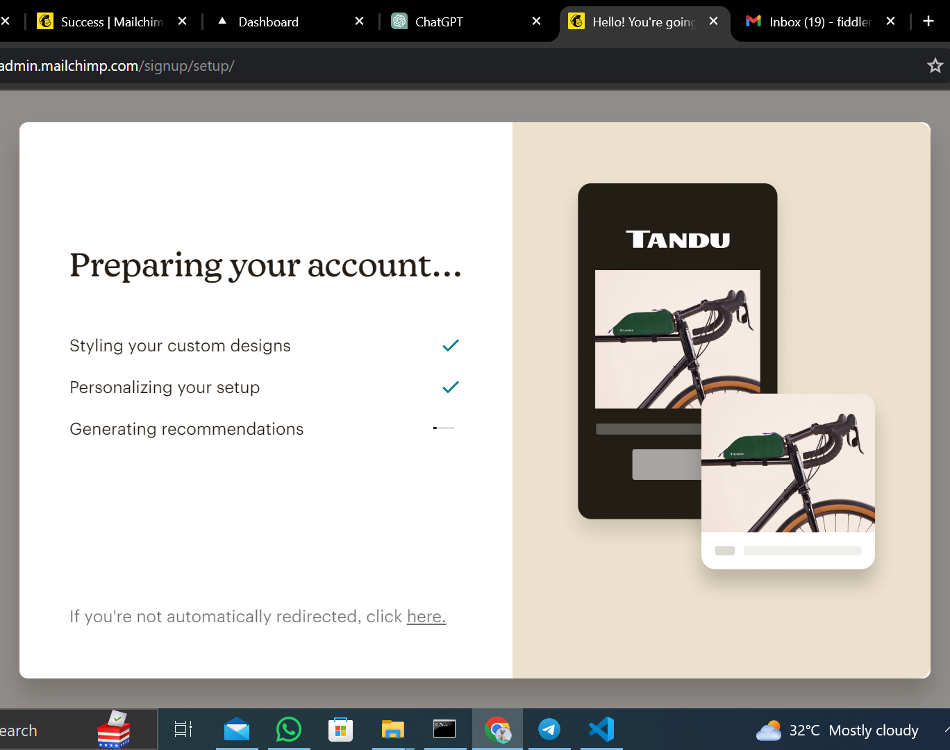
Account Preparation

Slide 6
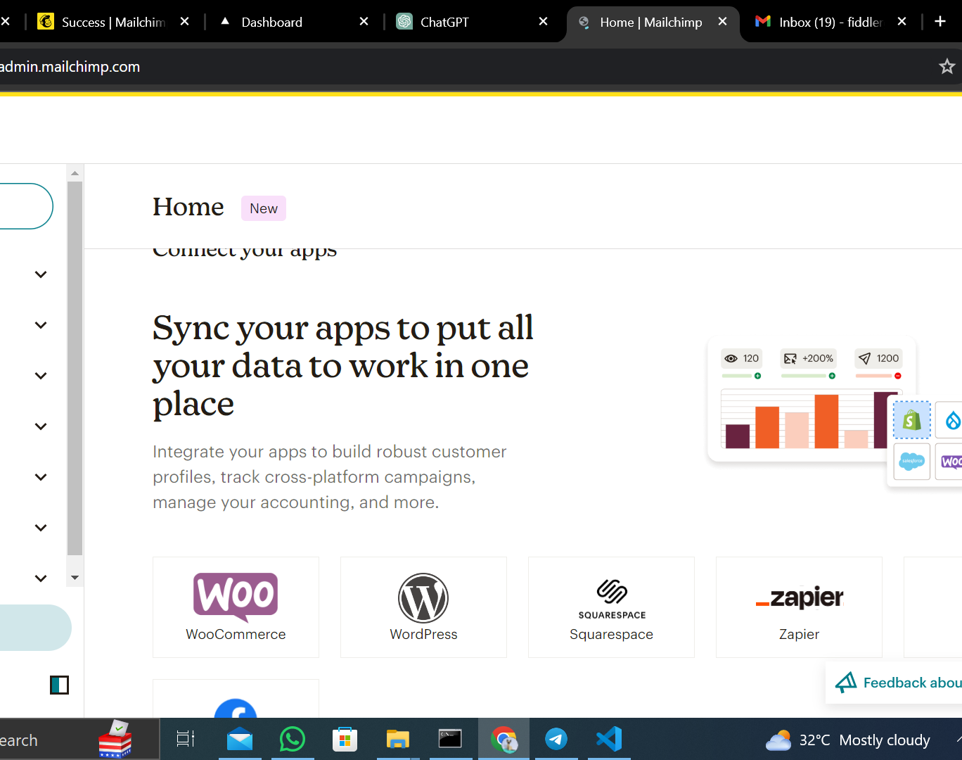
Sync your app

Slide 7
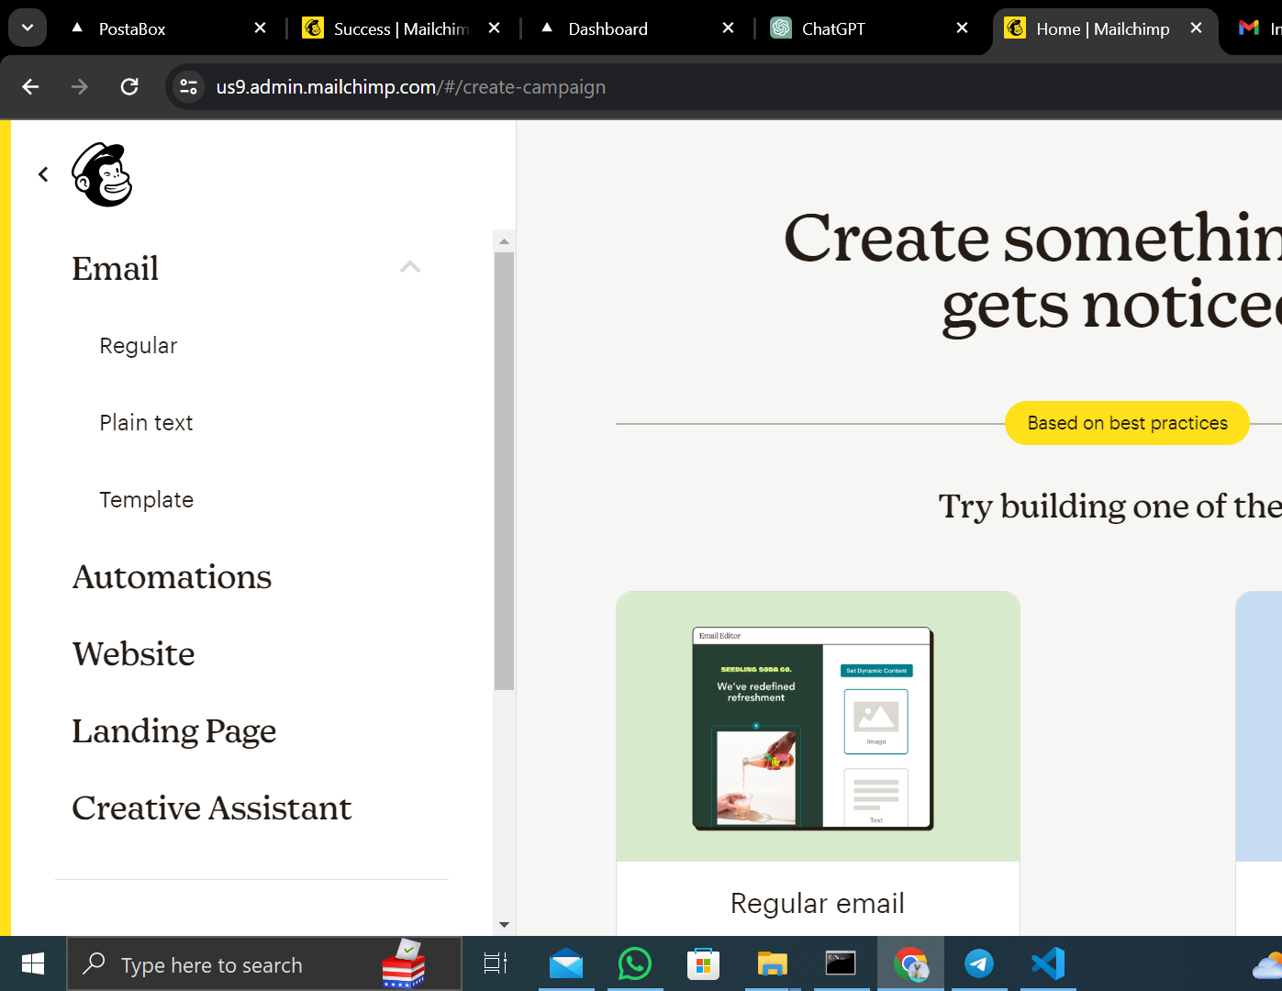
Sending Emails Proper
Step 1

Slide 8
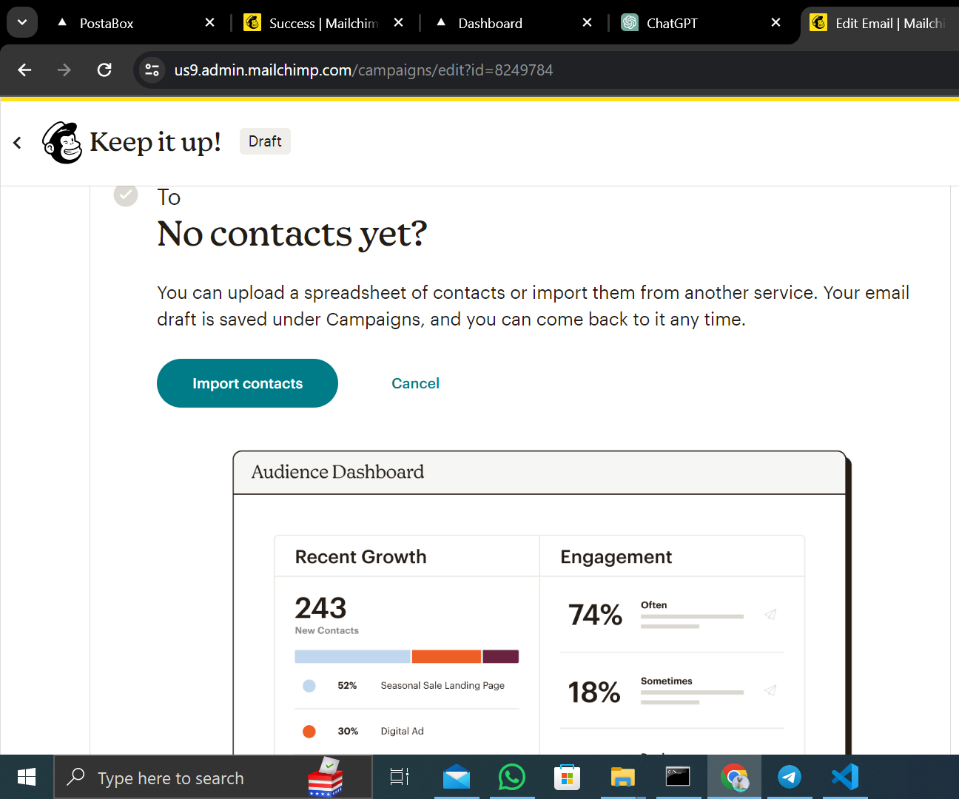
Importing Contacts

Slide 9
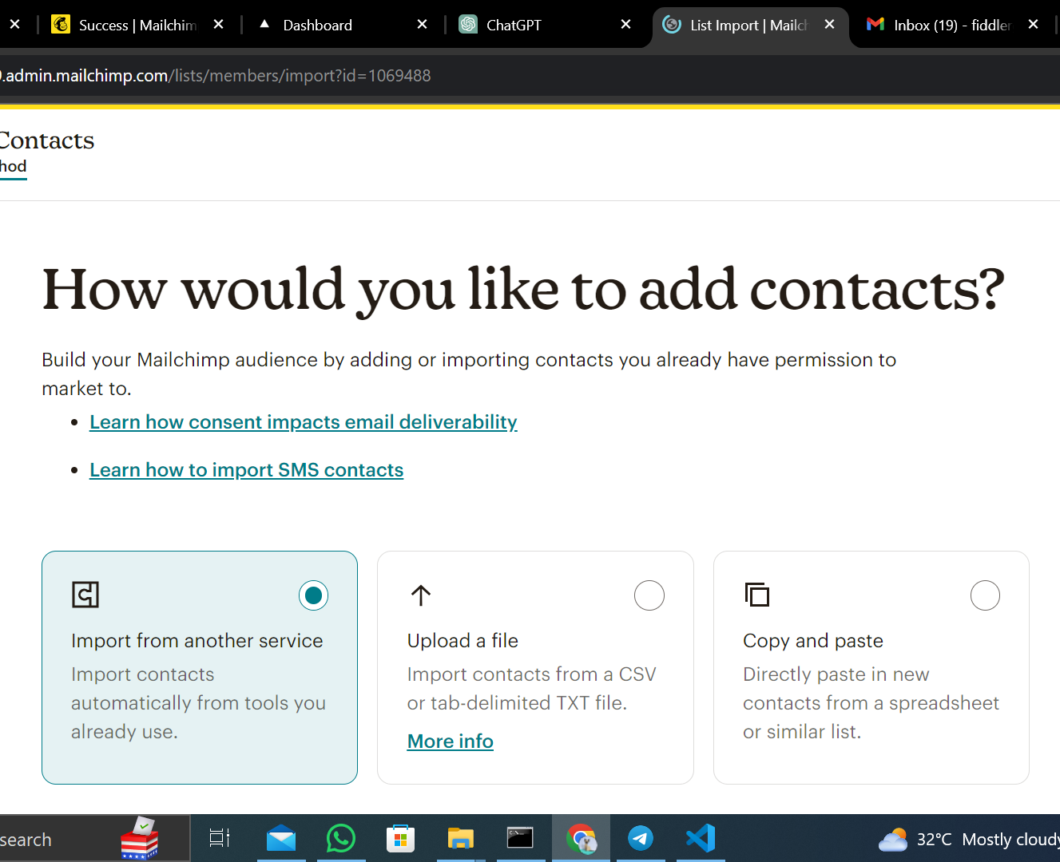
Different formats of importing contacts.
I chose the copy and paste method.

Slide 10
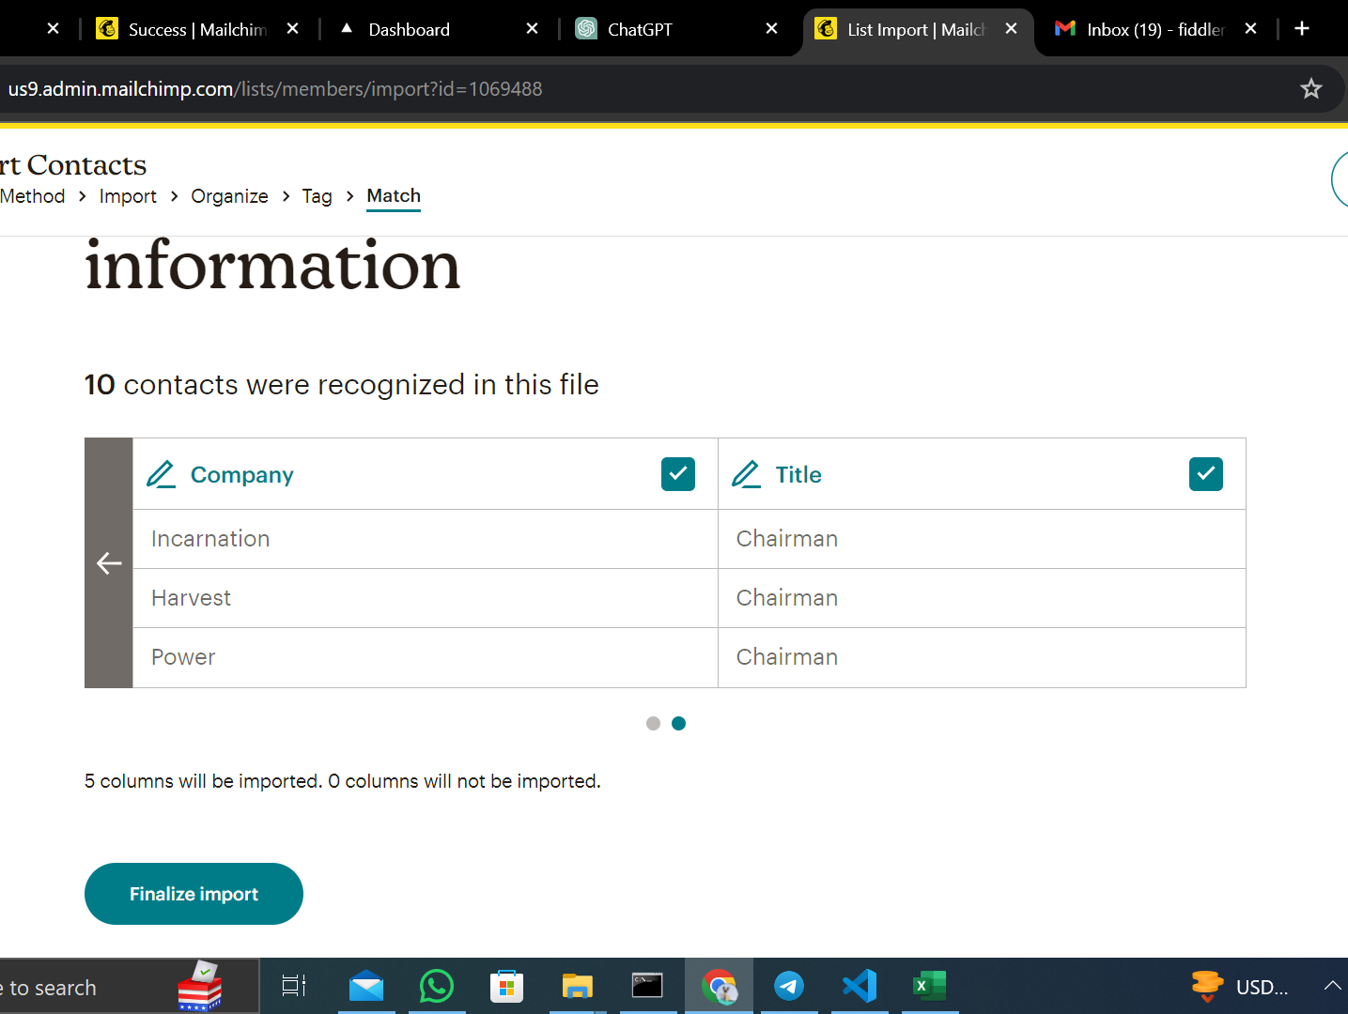
Final Amendments
Mostly to change the Column Headings to ones that their systems can read.

Slide 11
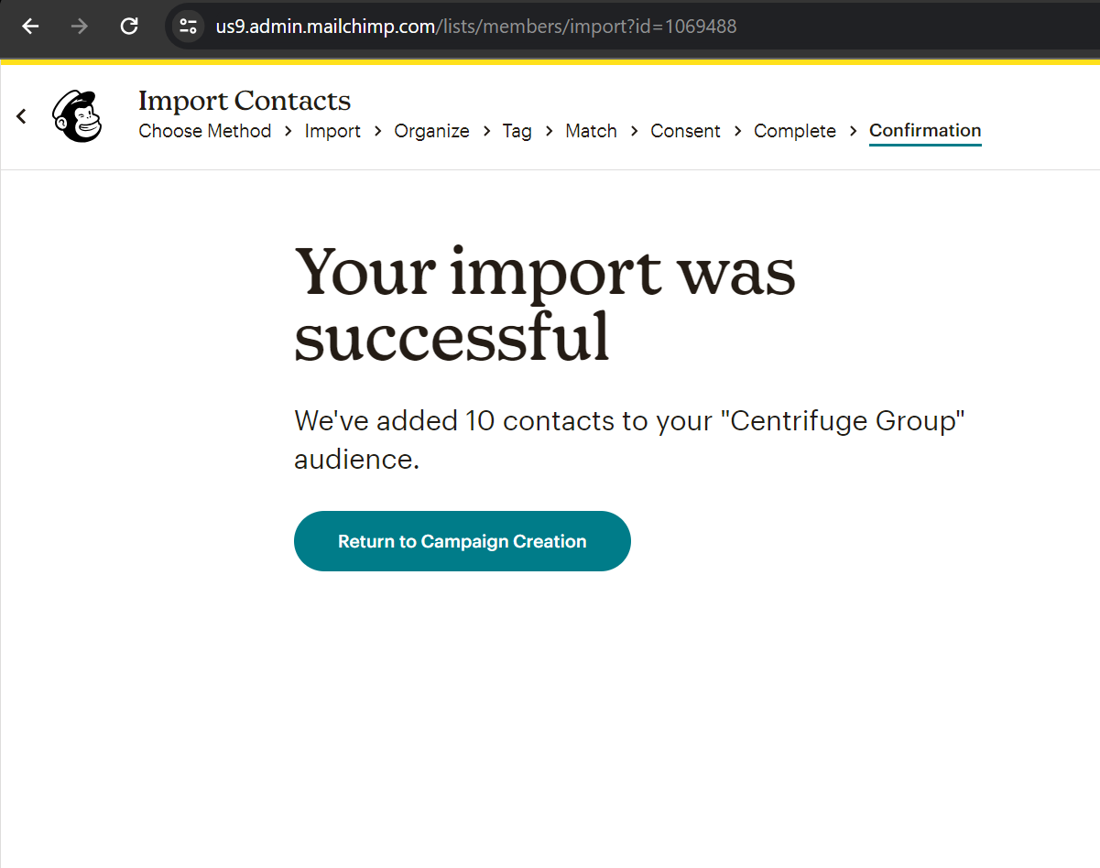
Import Prompt

Slide 12
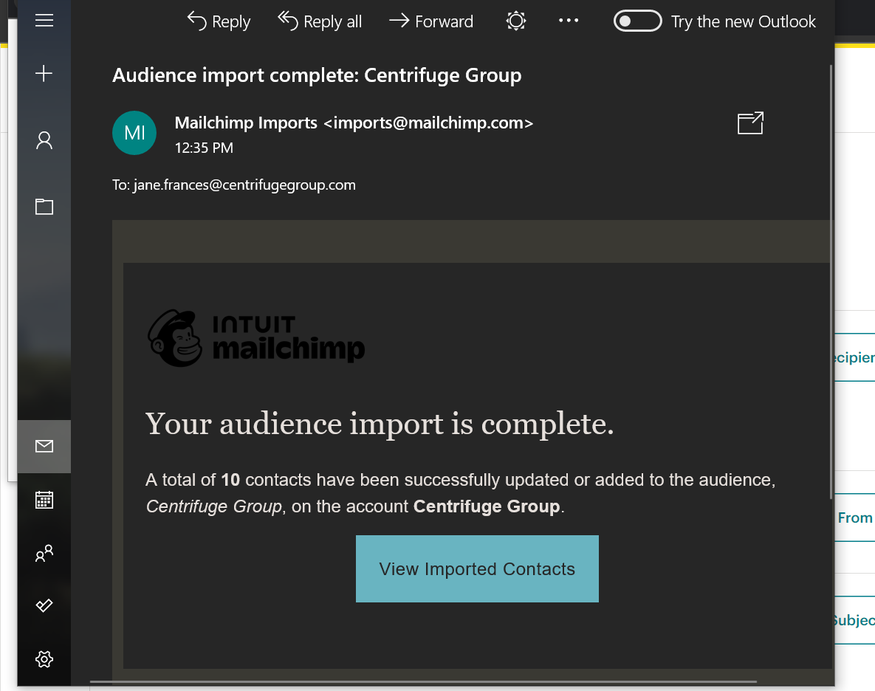
Email Notification Prompt

Slide 13
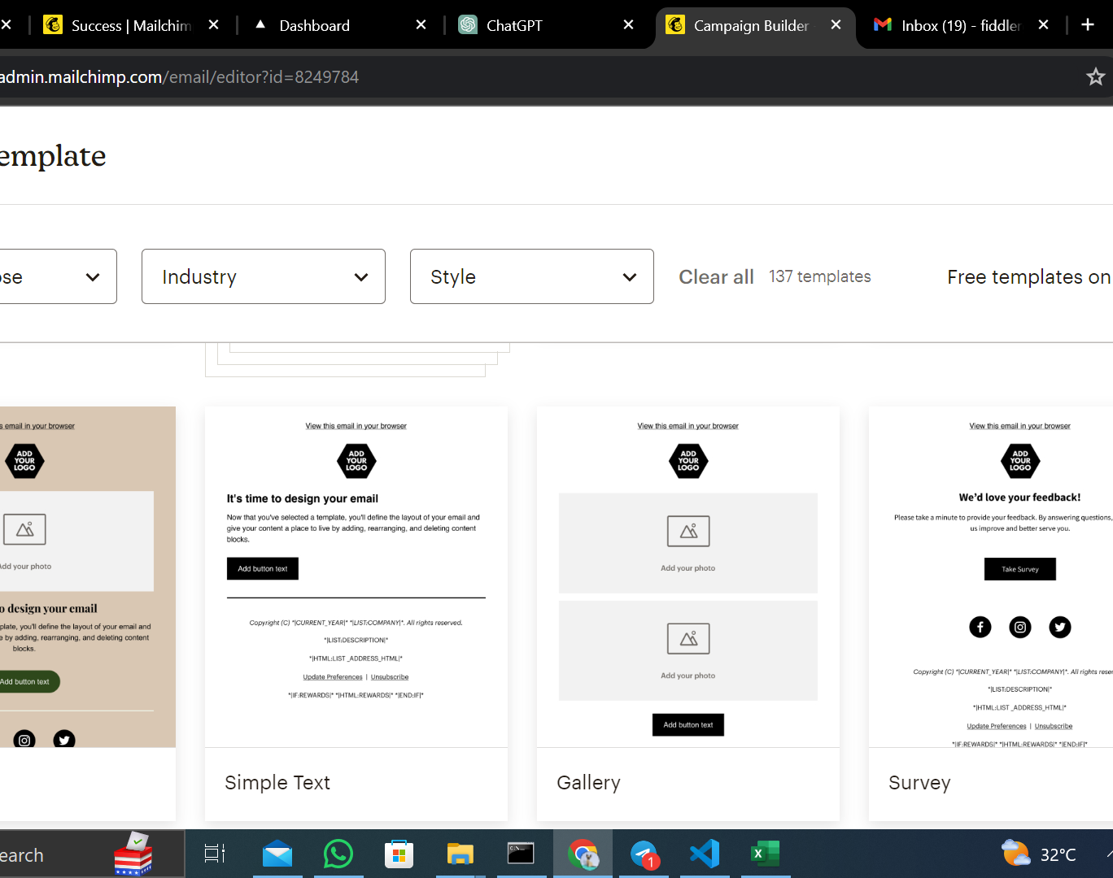
Back to Sending Emails.
Choose your template.

Slide 14
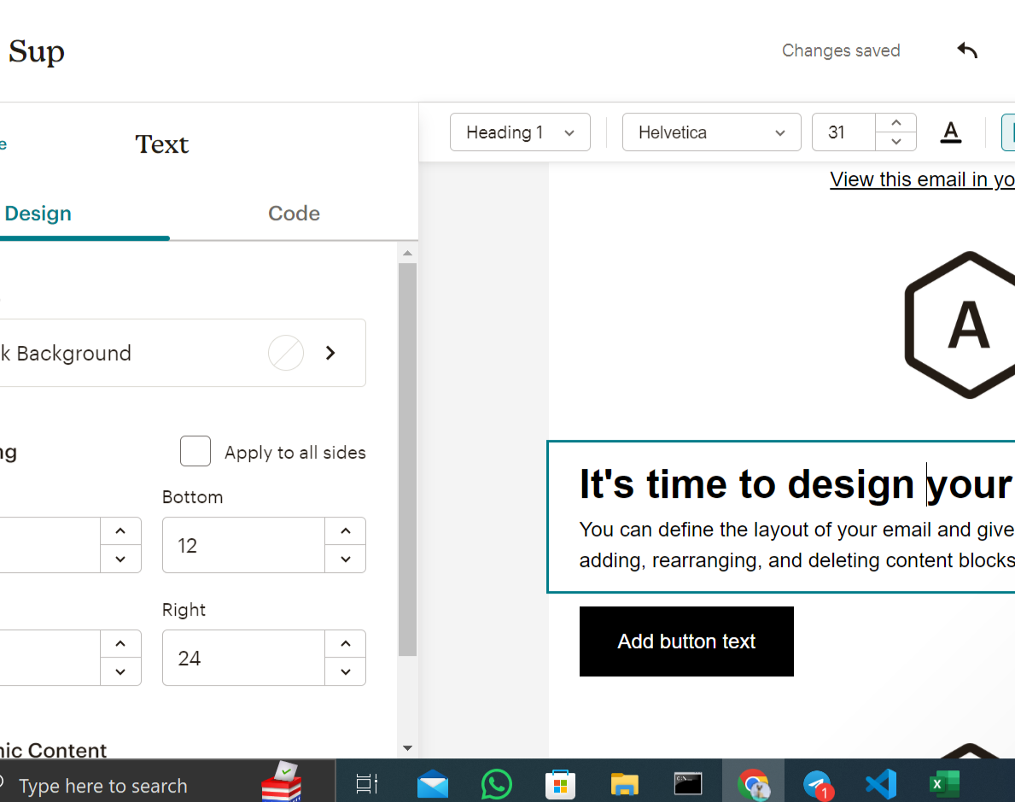
Edit your preferred template

Slide 15
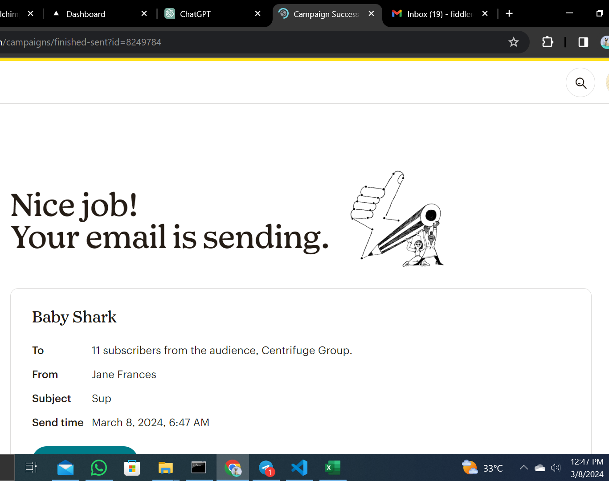
Email Sent.

Slide 16
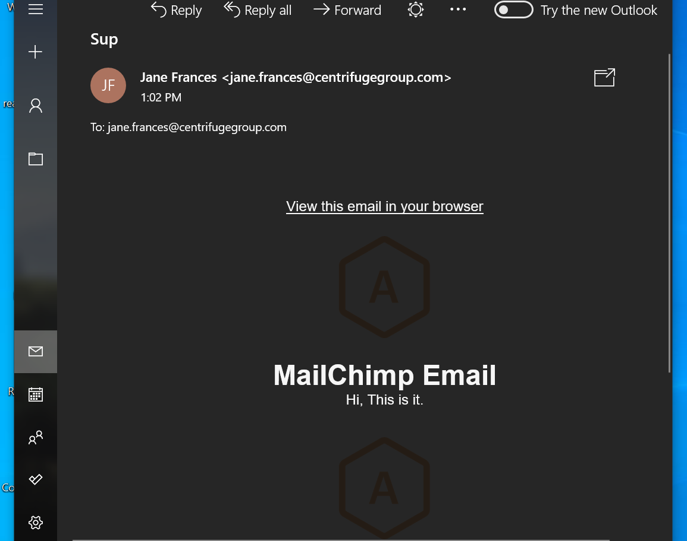
Email Received
A copy of the email sent.

